Slide 1












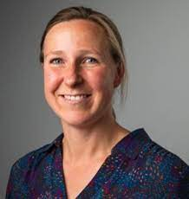
















Luke C. Pilling, PhD
Slides on my GitHub
GEMINI team Bethany Voller Dr Olivia Murrin Ruby Woodward Dr Ninon Mounier Dr Deniz Türkmen Dr João Delgado
Dr Lucía Carrasco
Dr Concepción Violán Prof Frank Dudbridge Prof Jane Masoli
Prof Jack Bowden Prof Tim Frayling (PI)
Department of Clinical and Biomedical Sciences
Genetic Insights into Ageing and Chronic Disease: Pathways, Penetrance, and Multimorbidity
Et al…!
Senior Lecturer in Genetic Epidemiology, University of Exeter, UK
Team Iron Mitchell Lucas Daniel Williamson Lucy Banfield Dr Francesco Casanova Dr Jeremy Shearman Dr Janice Atkins Prof David Melzer
L.Pilling@exeter.ac.uk
lcpilling.github.io
lcpilling.bsky.social
DBC seminar @ UNIL
27 March 2025

Slide 2
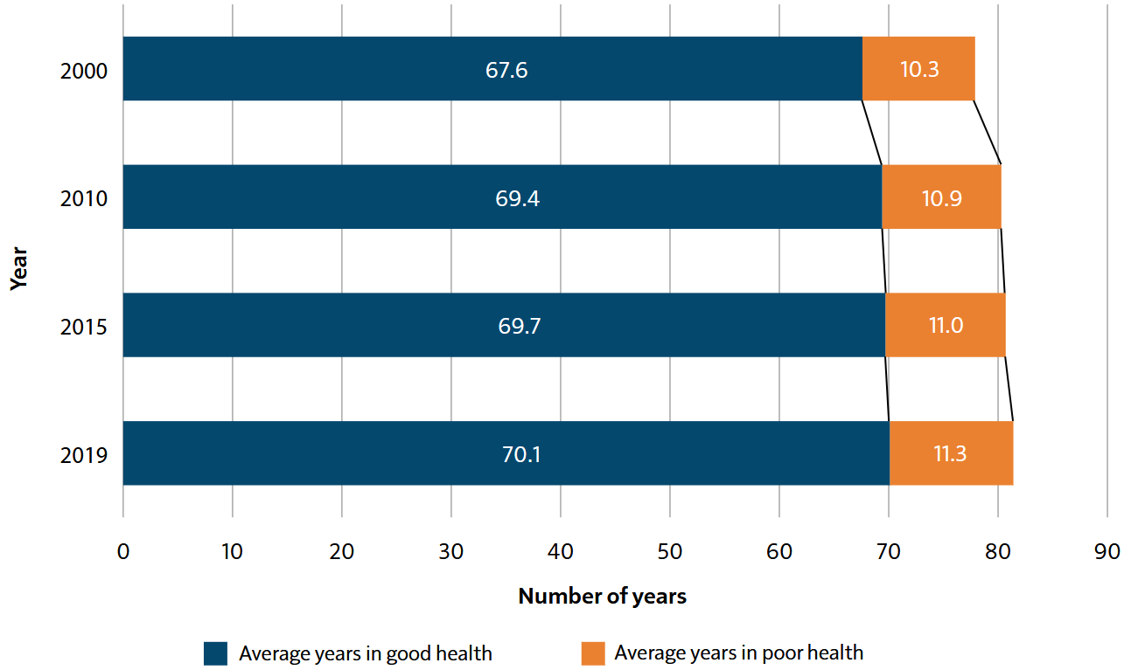
Despite improvements in longevity, the proportion of life spent in poorer health has changed little
Estimated number of years spent in good health and poorer health in the UK, 2000 to 2019
UK Chief Medical Officer’s 2023 Annual Report: Health in an Ageing Society
Source data: World Health Organization, The Global Health Observatory - Life expectancy and Healthy life expectancy

Slide 3
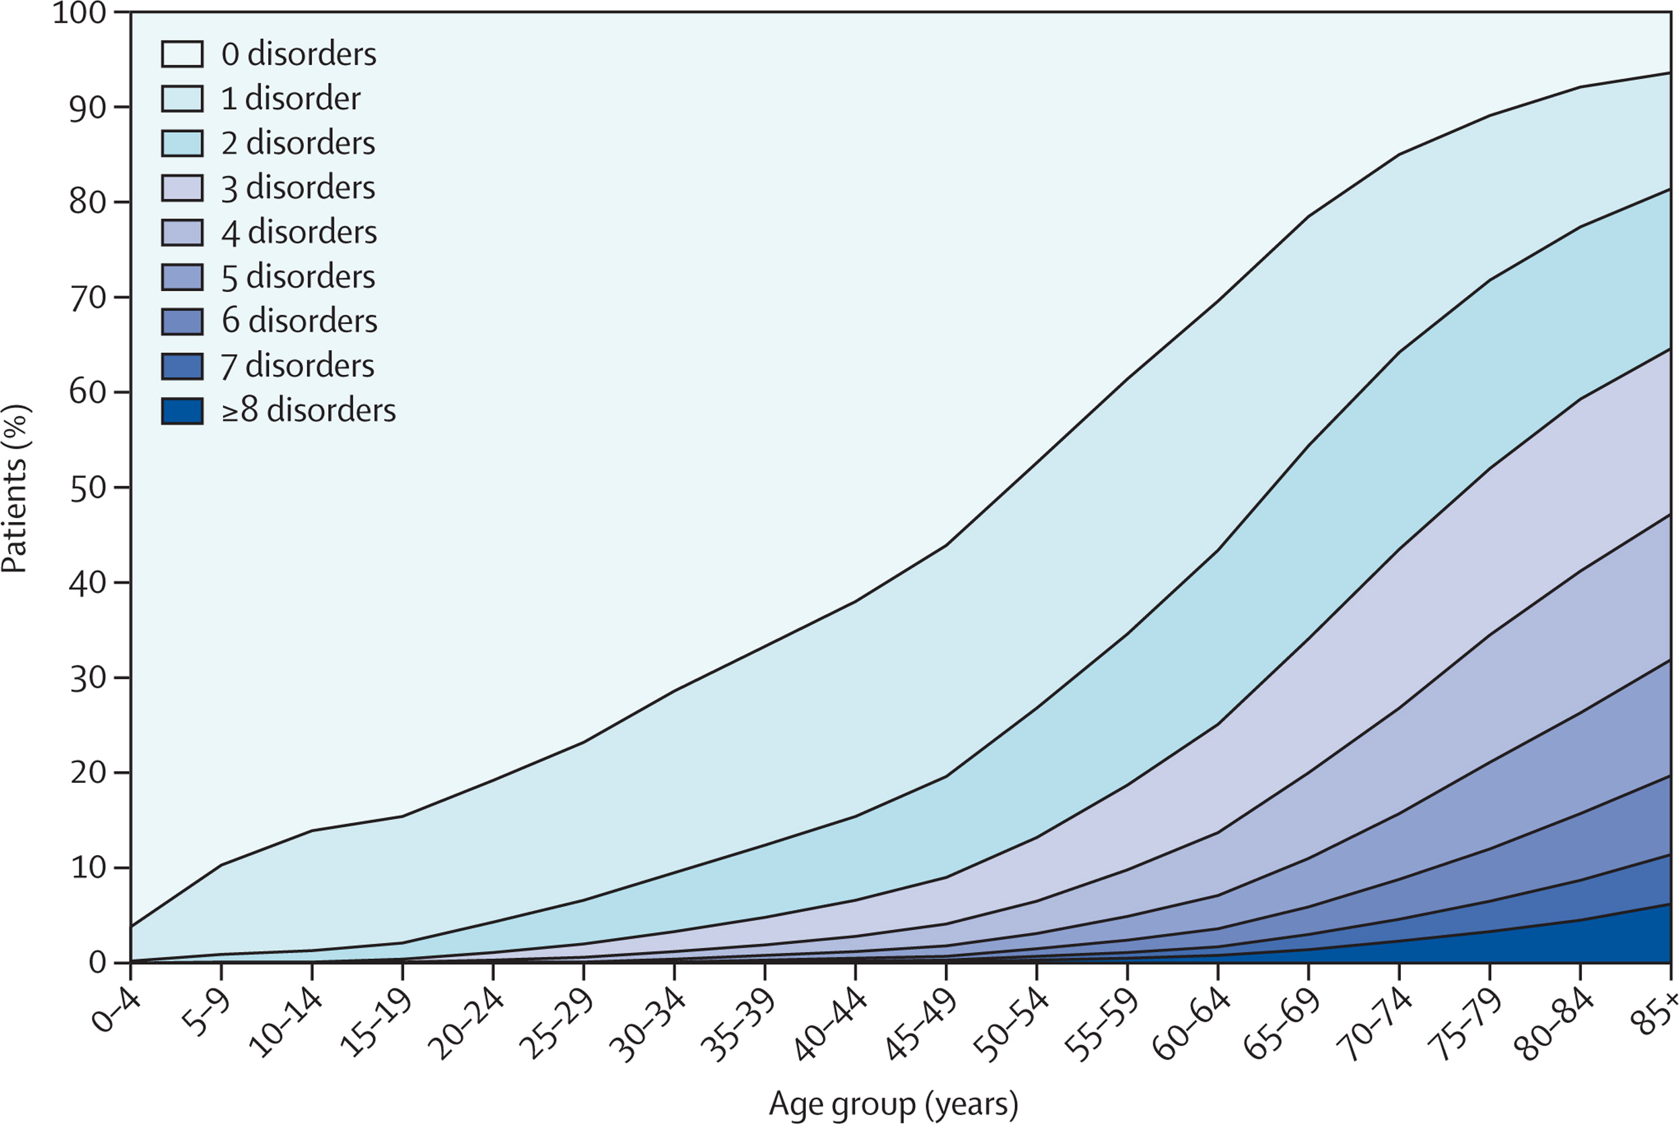
Ageing and accumulation of chronic diseases [multimorbidity]
Number of concurrent chronic disorders by age-group
Data on 40 morbidities from a database of 1,751,841 people registered with 314 medical practices in Scotland in March 2007
Barnett et al. “Epidemiology of multimorbidity and implications for health care, research, and medical education: a cross-sectional study” The Lancet, 2012. doi:10.1016/S0140-6736(12)60240-2

Slide 4
Medicine often treats diseases individually – a single patient sees multiple specialists
Yet diseases may share risk factors, interact in patients, or have competing treatments
Increasing fragmentation of research
Increasing need to account for multimorbidity
Increasing severity or complexity of conditions a person has
Figure adapted from:
Pati et al. “Defining and measuring complex multimorbidity: a critical analysis” British Journal of General Practice, 2023. doi:10.3399/bjgp23X734661

Slide 5
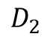
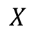
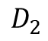
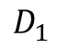
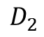
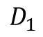
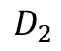
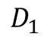
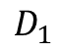
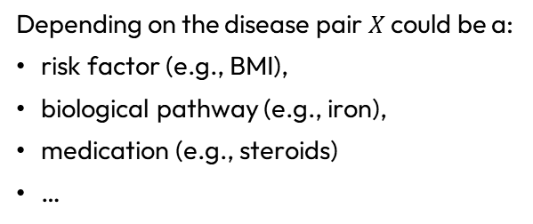


Multimorbidity and causal pathways
?
For a particular pair of diseases that co-occur in patients – what is the link? Possible intervention?
$$D_{1}$$
$$D_{2}$$
$$D_{1}$$
$$D_{2}$$
$$D_{1}$$
$$D_{2}$$
$$D_{1}$$
$$D_{2}$$
$$X$$
$$X$$
$$X$$
Depending on the disease pair $X$ could be a:
risk factor (e.g., BMI),
biological pathway (e.g., iron),
medication (e.g., steroids)
…
This talk brings together 3 projects:
GEMINI – using genetics to understand mechanisms in multimorbidity
HFE – genetic iron overload: penetrance and modifiers
TWIST – triangulation of evidence in pharmaco-epidemiology

Slide 6





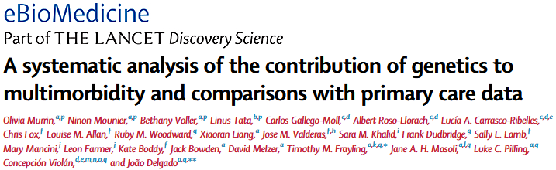


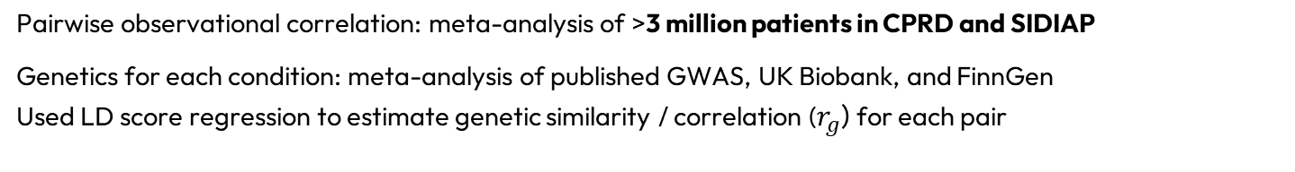
GEMINI: Genetic Evaluation of Multimorbidity towards INdividualisation of Interventions
Goal: find long-term conditions that co-occur in patients, share genetics, and determine shared mechanism(s)
3 years in 1 slide…
MR/W014548/1
PI: Prof Tim Frayling
72 long-term chronic conditions studied (2,546 pairs)
>0.5% prevalence in patients aged 65+ in CPRD and SIDIAP primary care cohorts
Significant genetic heritability (LDSC z-score>4) in UK Biobank
Pairwise observational correlation: meta-analysis of >3 million patients in CPRD and SIDIAP
Genetics for each condition: meta-analysis of published GWAS, UK Biobank, and FinnGen Used LD score regression to estimate genetic similarity / correlation ($r_{g}$) for each pair
Dr Olivia Murrin Bethany Voller Dr Ninon Mounier Carlos Gallego-Moll
Et al…!
Murrin et al. “A systematic analysis of the contribution of genetics to multimorbidity and comparisons with primary care data” eBioMedicine, 2025. doi:10.1016/j.ebiom.2025.105584

Slide 7
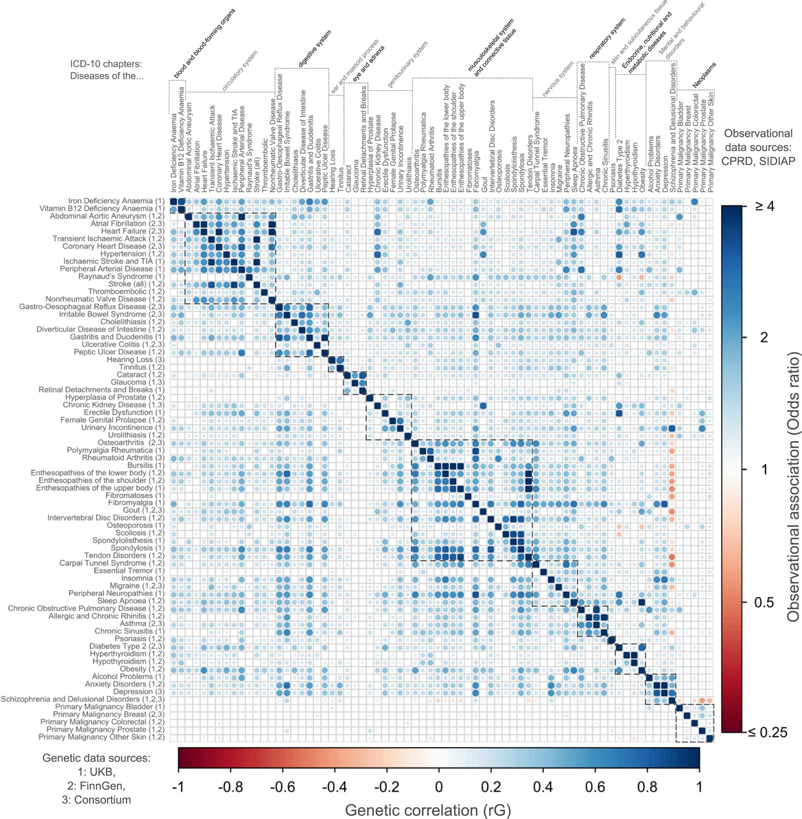

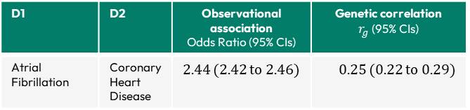
Interactive version and downloads:
gemini-multimorbidity.shinyapps.io/atlas
72 long-term chronic conditions 2,546 pairs
Substantial correlation in the observational data (patient cohorts)
Logistic regressions adjusted for age and sex
Evidence of shared genetics for 1,631 pairs of conditions (LDSC)
221 within-domain pairs, 1410 cross-domain pairs
D1 | D2 | Observational association Odds Ratio (95% CIs) | Genetic correlation $r_{g}$(95% CIs)
Atrial Fibrillation | Coronary Heart Disease | 2.44 (2.42 to 2.46) | 0.25 (0.22 to 0.29)
Osteoarthritis | Type 2 Diabetes | 1.25 (1.24 to 1.26) | 0.22 (0.18 to 0.26)
Rheumatoid Arthritis | Skin Cancer | 1.15 (1.12 to 1.18) | -0.14 (-0.21 to -0.06)
Dr Olivia Murrin Bethany Voller Dr Ninon Mounier Carlos Gallego-Moll
Shared genetics implies shared causal mechanisms… But what are they?
Et al…!
Murrin et al. eBioMedicine, 2025. doi:10.1016/j.ebiom.2025.105584

Slide 8
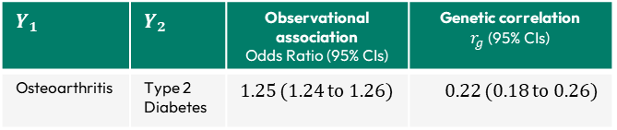
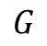

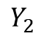
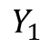
How much of the genetic correlation between conditions is due to obesity?
$$Y_{1}$$ | $$Y_{2}$$ | Observational association Odds Ratio (95% CIs) | Genetic correlation $r_{g}$(95% CIs)
Osteoarthritis | Type 2 Diabetes | 1.25 (1.24 to 1.26) | 0.22 (0.18 to 0.26)
$$Y_{1}$$
$$Y_{2}$$
Remaining genetic correlation
$$X$$
$$G$$
We asked “How much of the shared genetic correlation disappears between condition 1 ($Y_{1}$) and condition 2 ($Y_{2}$), after accounting for the genetics of obesity ($X$)?”

Slide 9
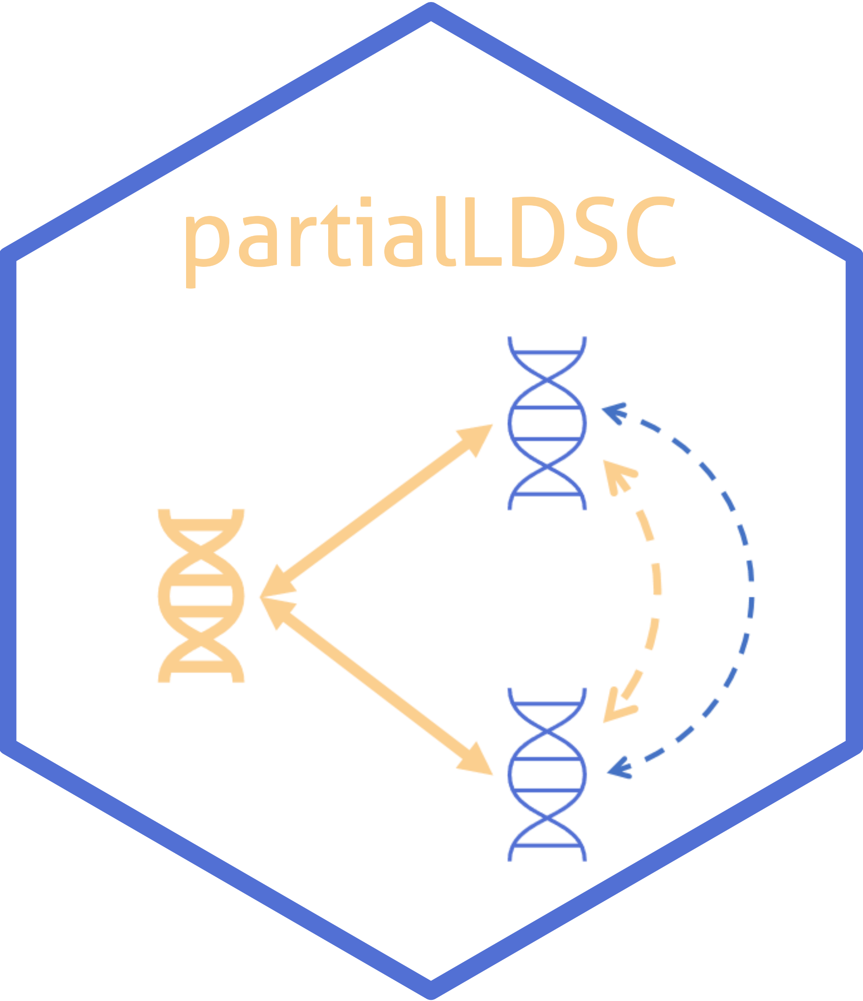

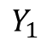
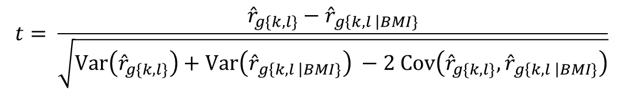
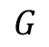
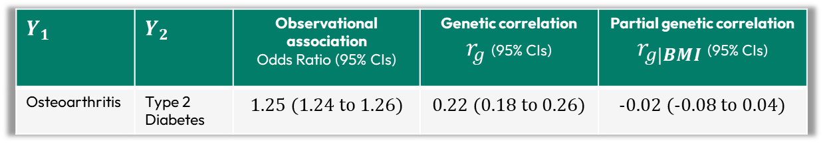


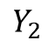
Calculating partial pairwise genetic correlations
${\hat{ρ}}_{g\{k,l\}}$: genetic covariance between conditions k and l
Led by Dr Ninon Mounier
${\hat{ρ}}_{g\{k,BMI\}}$ : genetic covariance between condition k and BMI
github.com/GEMINI-multimorbidity/partialLDSC
${\hat{ρ}}_{g\{BMI,l\}}$ : genetic covariance between BMI and condition l
${\hat{h}}_{\{BMI\}}^{2}$: heritability of BMI
${\hat{h}}_{\{l|BMI\}}^{2}$: heritability of trait l adjusted for heritability of BMI
$$Y_{1}$$
$$Y_{2}$$
$$Y_{1}$$ | $$Y_{2}$$ | Observational association Odds Ratio (95% CIs) | Genetic correlation $r_{g}$(95% CIs) | Partial genetic correlation $r_{g|BMI}$(95% CIs)
Osteoarthritis | Type 2 Diabetes | 1.25 (1.24 to 1.26) | 0.22 (0.18 to 0.26) | -0.02 (-0.08 to 0.04)
$${\hat{r}}_{g\left\{k,l \right|BMI\}}=\frac{{\hat{ρ}}_{g\left\{k,l \right|BMI\} }}{\sqrt{{{\hat{h}}^{2}}_{\left\{k \right|BMI\}}⋅{{\hat{h}}^{2}}_{\left\{l \right|BMI\}}}}$$
Obtain partial genetic correlation
Test for the difference between unadjusted and partial genetic correlations
X
$$X$$
X
$$t= \frac{{\hat{r}}_{g\{k,l\}}−{\hat{r}}_{g\left\{k,l \right|BMI\}}}{\sqrt{Var\left({\hat{r}}_{g\{k,l\}}\right)+Var\left({\hat{r}}_{g\left\{k,l \right|BMI\}}\right) −2 Cov\left({\hat{r}}_{g\{k,l\}},{\hat{r}}_{g\left\{k,l \right|BMI\}}\right)}}$$
$$G$$
$Var\left({\hat{r}}_{g\left\{k,l \right|BMI\}}\right)$ and $Cov\left({\hat{r}}_{g\{k,l\}},{\hat{r}}_{g\left\{k,l \right|BMI\}}\right)$ estimated using a block jackknife approach (200 blocks)
Mounier et al. “Genetics identifies obesity as a shared risk factor for co-occurring multiple long-term conditions.” medRxiv. 2024. doi:10.1101/2024.07.10.24309772

Slide 10
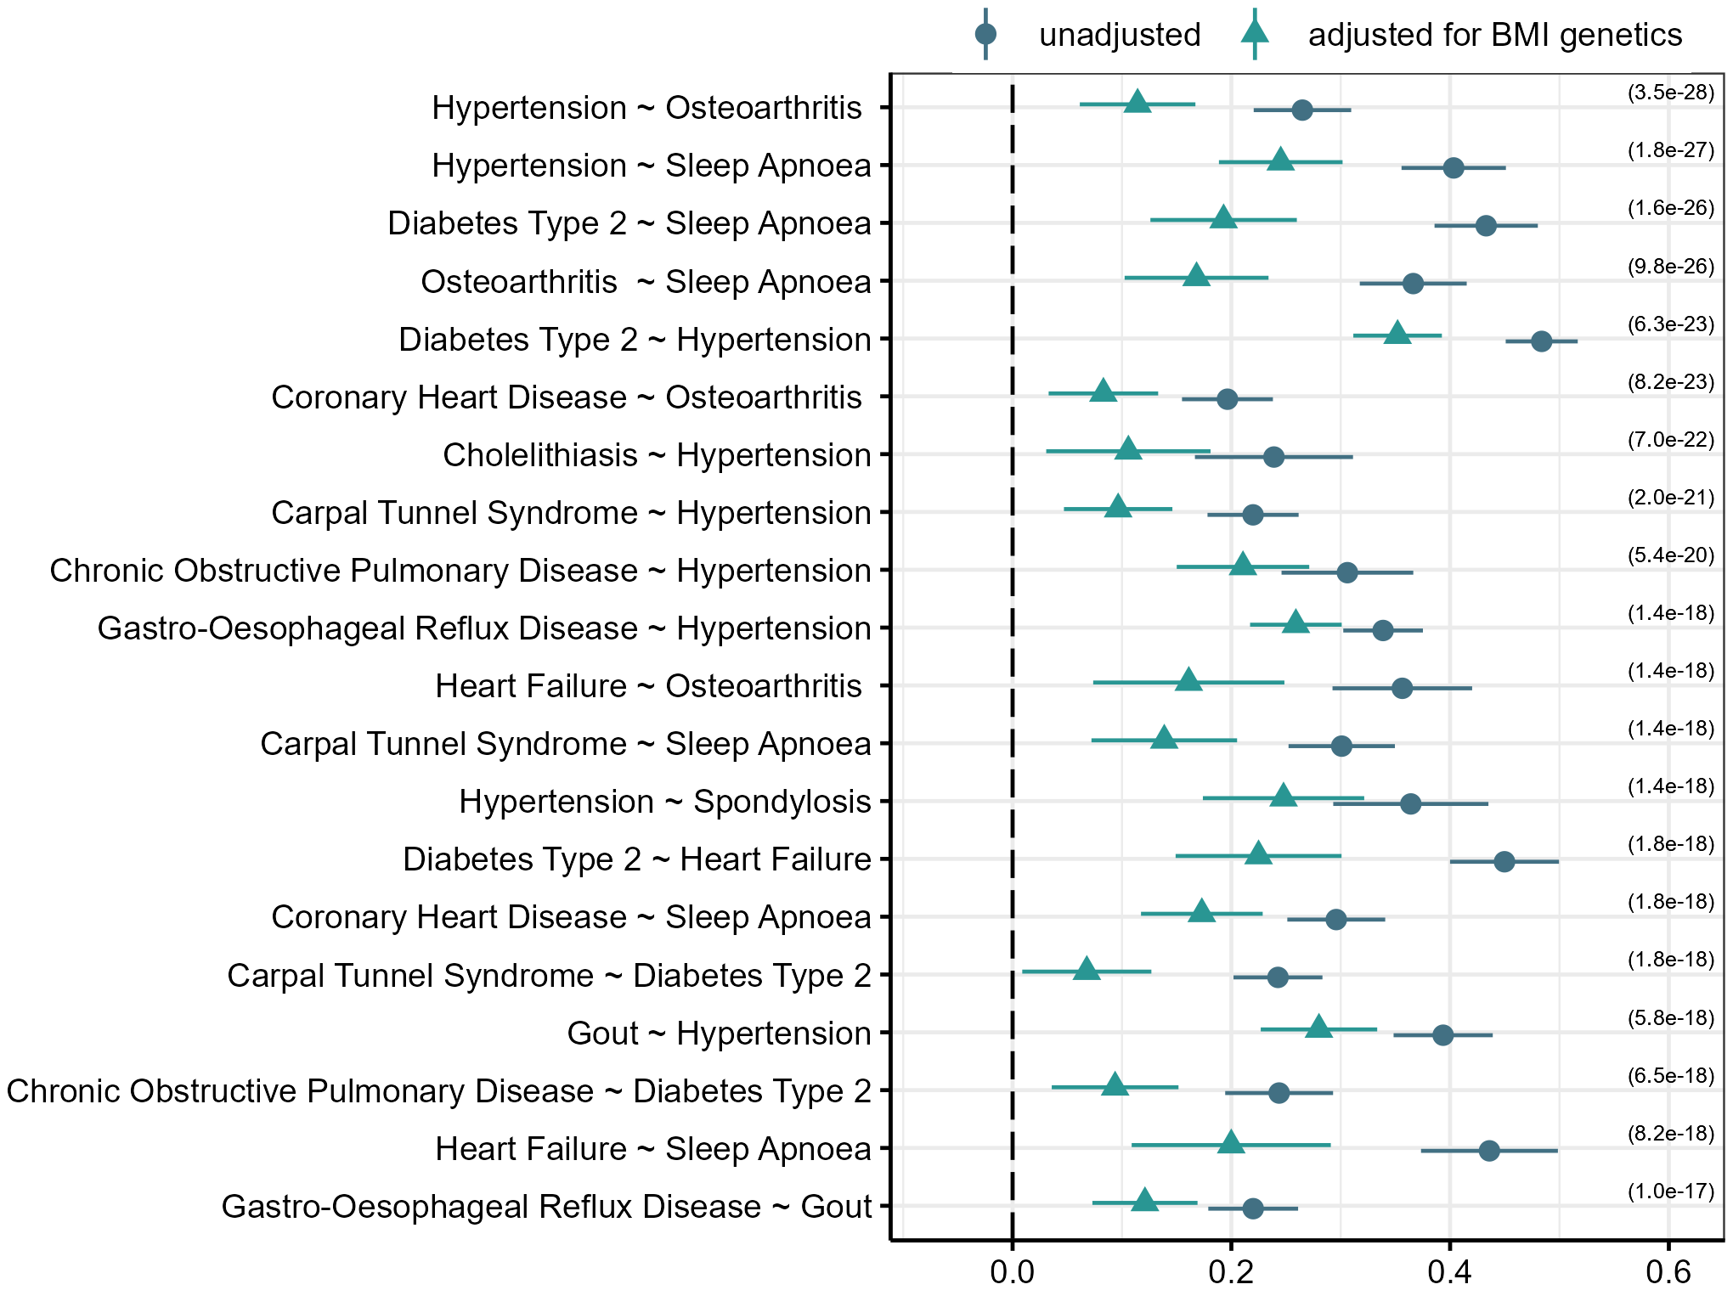
Condition pairs where BMI significantly attenuates the genetic correlation
Led by Dr Ninon Mounier
github.com/GEMINI-multimorbidity/partialLDSC
FDR adjusted statistically significant difference when adjusting for BMI genetics in 1,362/2,546 pairs
Top 20 with largest before/after adjustment shown
$$Y_{1}$$
$$Y_{2}$$
+
+
$$X$$
$$G$$
Consistent with increasing BMI increasing risk of both LTCs
$r_{g|BMI}$(95% CIs)
Mounier et al. “Genetics identifies obesity as a shared risk factor for co-occurring multiple long-term conditions.” medRxiv. 2024. doi:10.1101/2024.07.10.24309772

Slide 11
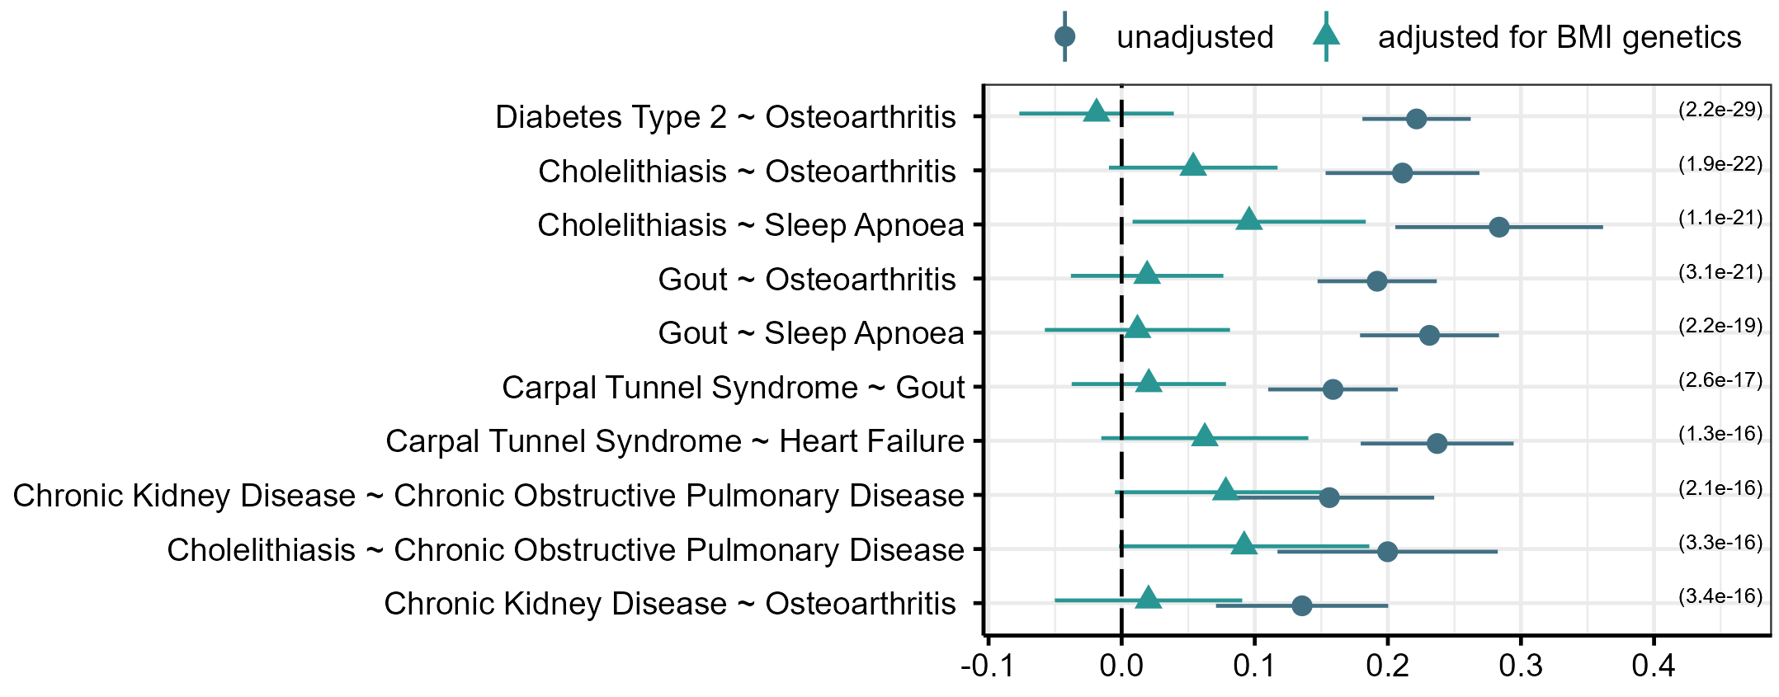
Condition pairs where BMI is the major cause of genetic correlation
Led by Dr Ninon Mounier
github.com/GEMINI-multimorbidity/partialLDSC
$$Y_{1}$$
$$Y_{2}$$
X
$$X$$
X
$$G$$
$r_{g|BMI}$(95% CIs)
For 161/1362, BMI accounts for a substantial amount of the correlation
Almost all (154/161) were cross-domain pairs
E.g. diseases of (1) circulatory system & (2) musculoskeletal system
Mounier et al. “Genetics identifies obesity as a shared risk factor for co-occurring multiple long-term conditions.” medRxiv. 2024. doi:10.1101/2024.07.10.24309772

Slide 12
Summary so far…
Substantial observational and genetic correlation between long-term conditions
Shared causes in multimorbidity!
For 55% of condition-pairs tested, we observed a change in the genetic correlation when accounting for BMI genetics
Confirms the pivotal role of obesity in many correlated conditions
Successful Interventions on BMI could reduce the prevalence of pairs of conditions
But what drives the remaining genetic overlap between conditions?
Three quick examples of our ongoing work
Murrin et al. “A systematic analysis of the contribution of genetics to multimorbidity and comparisons with primary care data” eBioMedicine, 2025. doi:10.1016/j.ebiom.2025.105584
Mounier et al. “Genetics identifies obesity as a shared risk factor for co-occurring multiple long-term conditions.” medRxiv. 2024. doi:10.1101/2024.07.10.24309772

Slide 13
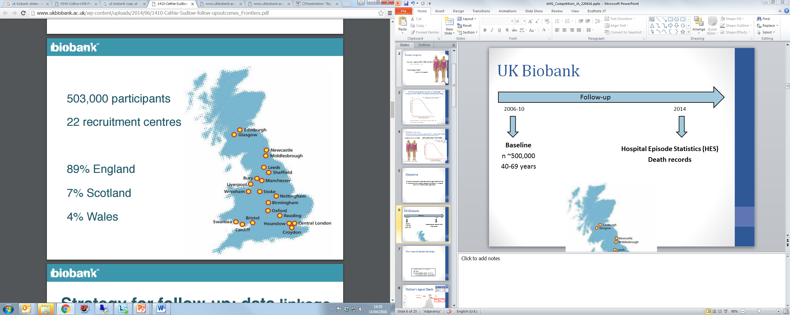



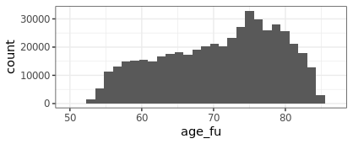
UK Biobank
Baseline (2006-2010):
n=500,000 (community volunteer sample)
22 assessment centres (England/Scotland/Wales)
40-70 years
Questionnaires; Physiological assessment
Blood sample; Genetics
Follow-up (to 30 October 2022):
Hospital admission records
Cancer registry
Death certificates
Primary care records (~45% of cohort)
Mean 13.3 years
Age at censoring date (30 Oct 2022)
Age (years)
Automated biobank sample storage and analysis in Stockport UK

Slide 14
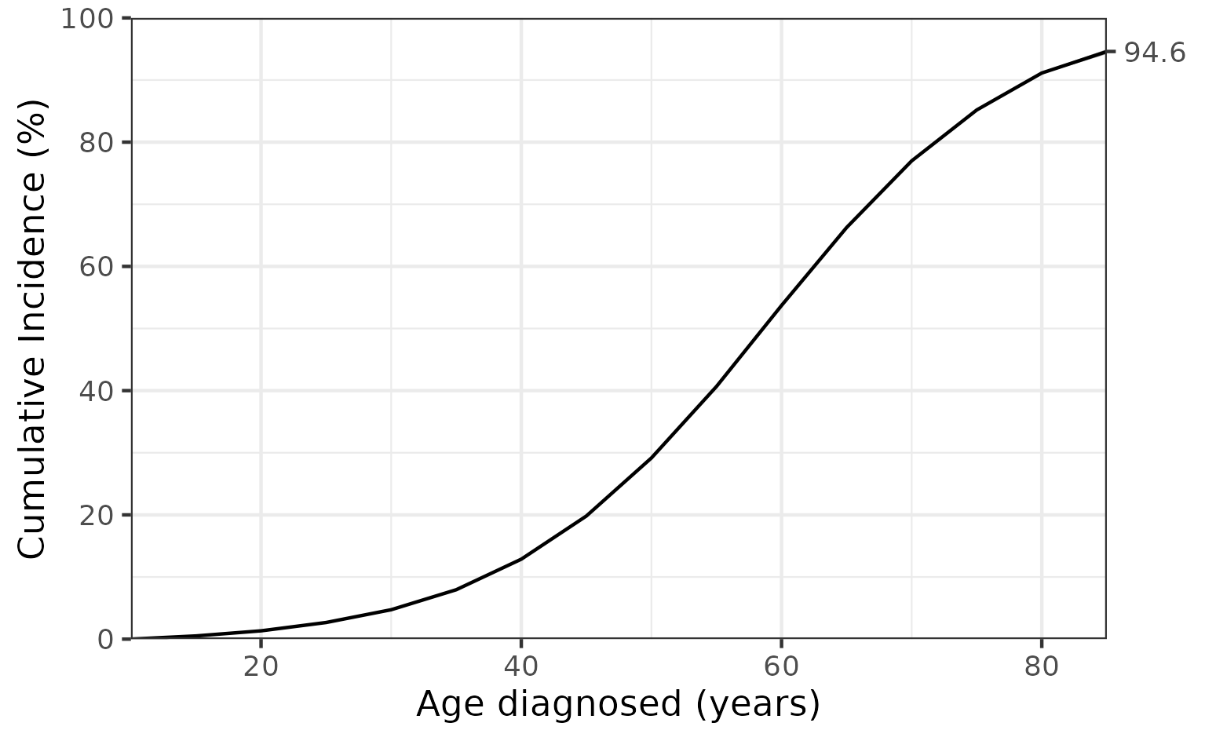
Multimorbidity in UK Biobank
Age diagnosed with first GEMINI long-term condition
Cumulative incidence analysis
In 490,383 participants with genome data:
n = 350,465 (71%) diagnosed with at least one GEMINI condition by end follow-up
Diagnoses from hospital inpatient admissions (HES), primary care (GP, 45% of cohort), or death records.
Censoring date: 30 October 2022 (up to 16 years after baseline assessment)
Unpublished work based on UKB data in main GEMINI analysis: Murrin et al. eBioMedicine, 2025. doi:10.1016/j.ebiom.2025.105584

Slide 15
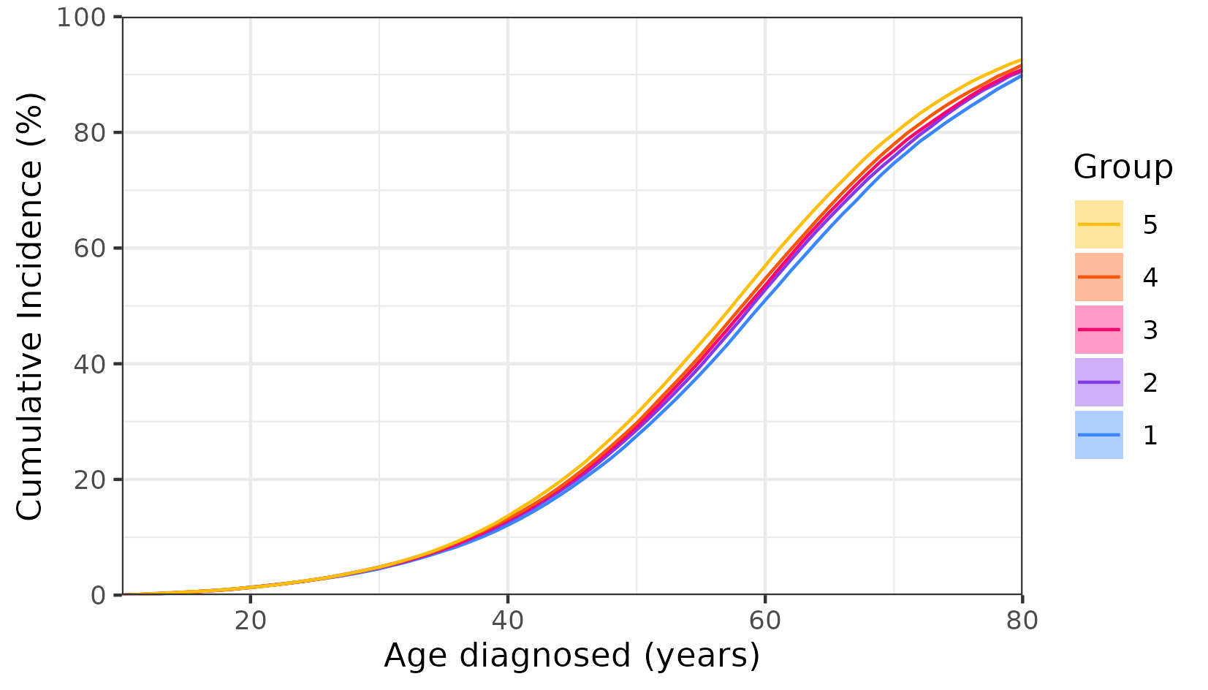
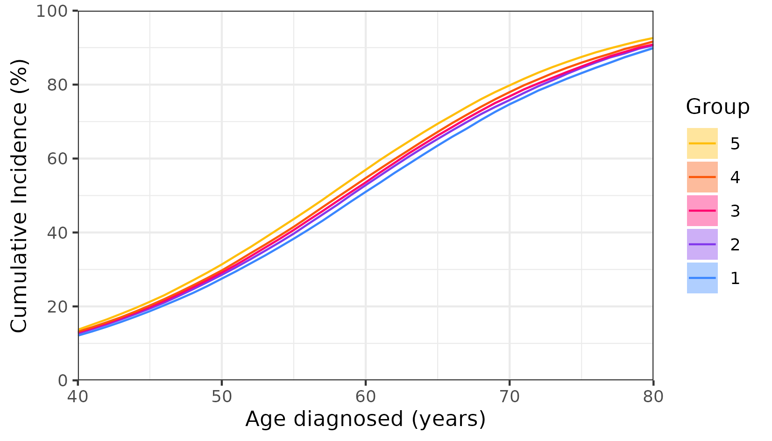
Multimorbidity in UK Biobank
Stratified by BMI polygenic score
Age diagnosed with first GEMINI long-term condition
Cumulative incidence analysis
In 451,447 participants of European genetic ancestry:
n = 322,413 (71%) diagnosed with at least one GEMINI condition by end follow-up
Diagnoses from hospital inpatient admissions (HES), primary care (GP, 45% of cohort), or death records.
Censoring date: 30 October 2022 (up to 16 years after baseline assessment)
Quintile of BMI polygenic score
Unpublished work based on UKB data in main GEMINI analysis: Murrin et al. eBioMedicine, 2025. doi:10.1016/j.ebiom.2025.105584

Slide 16
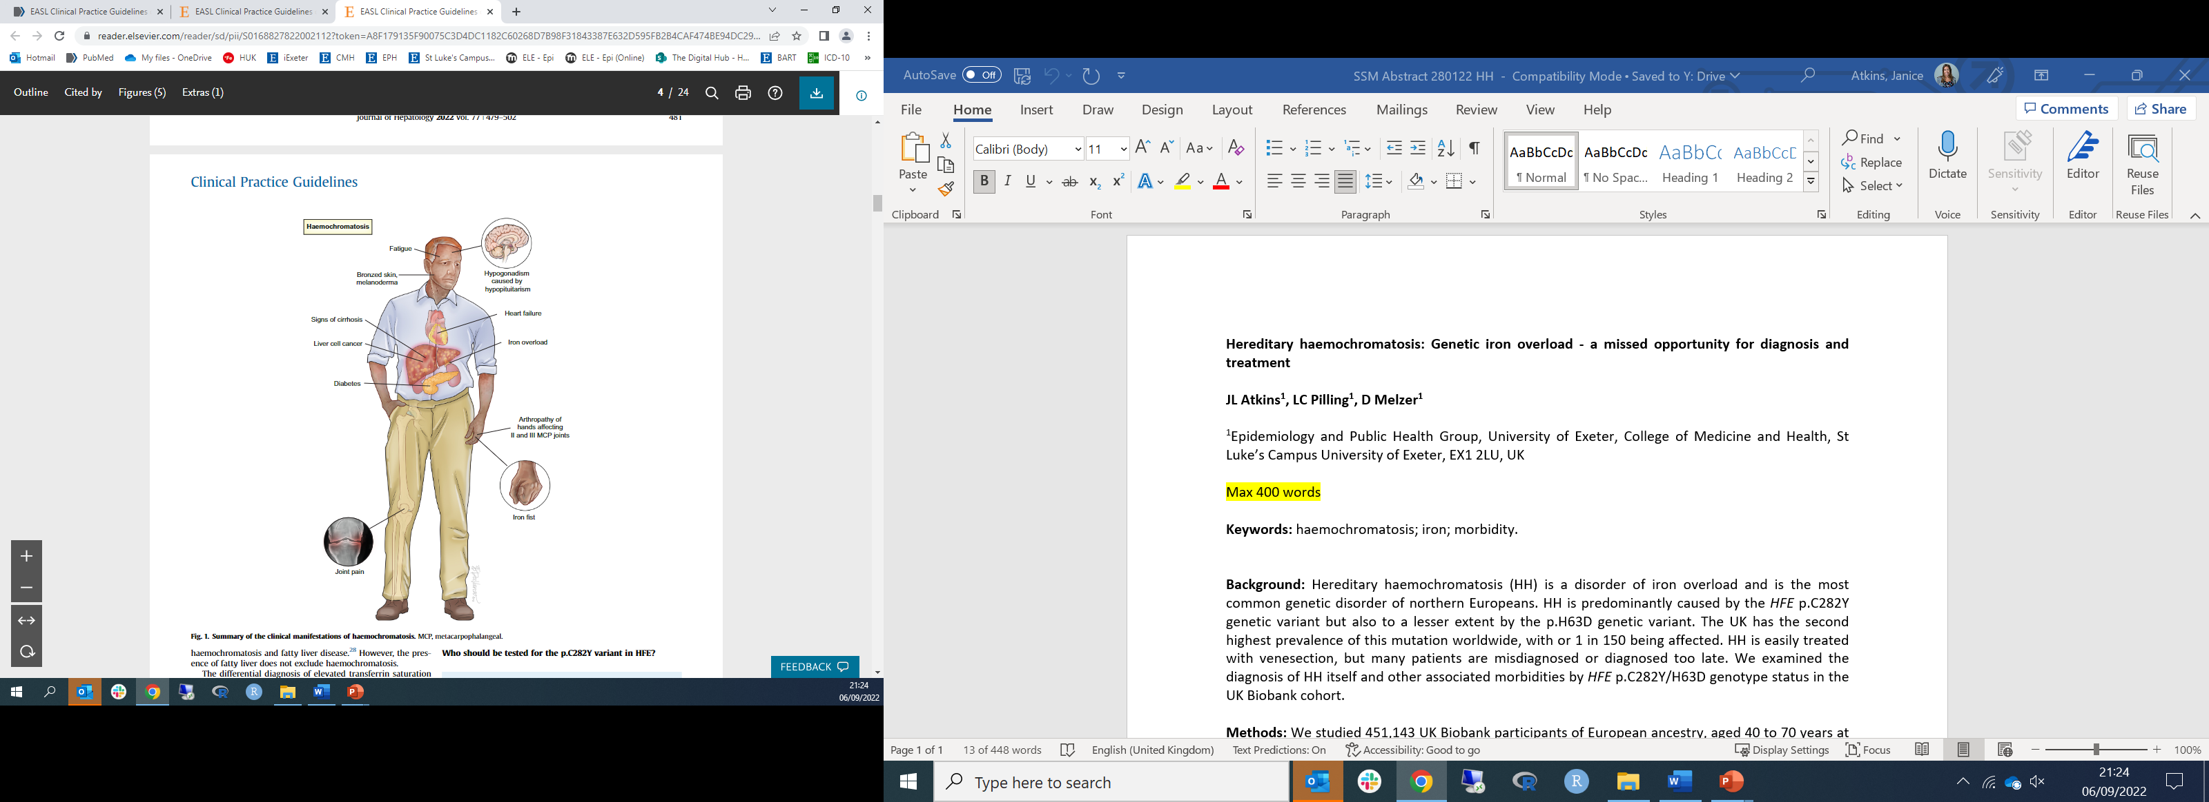
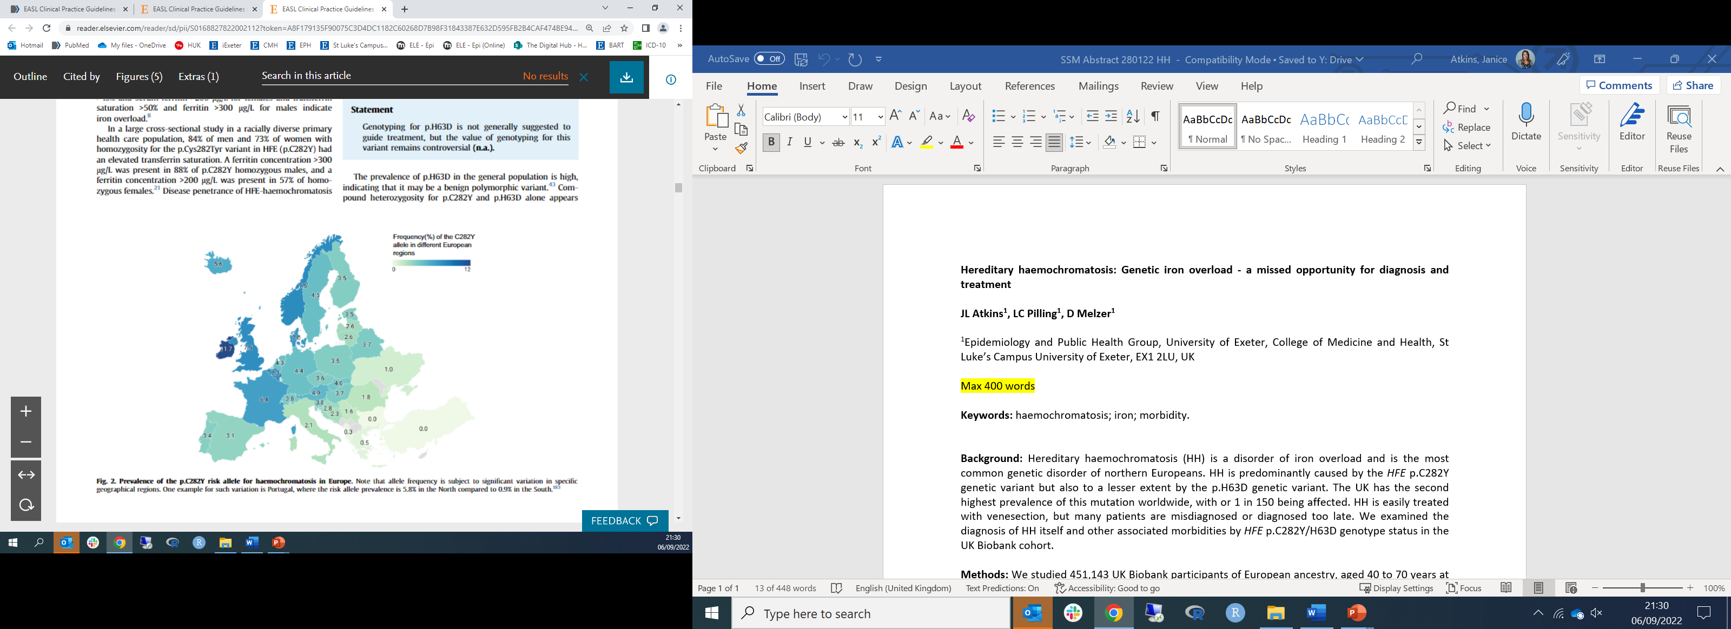
Haemochromatosis – iron overload disease
Caused by amino acid substitution p.C282Y in gene HFE
Most common genetic disorder in Northern Europeans (1 in 150)
Symptoms variable, penetrance estimates uncertain
Many diagnosed late/misdiagnosed
Screening not currently recommended in UK
Dr Janice Atkins
Prof David Melzer
Mitchell Lucas
Lucy Banfield
EASL Clinical Practice Guidelines on haemochromatosis. Journal of Hepatology, 2022

Slide 17
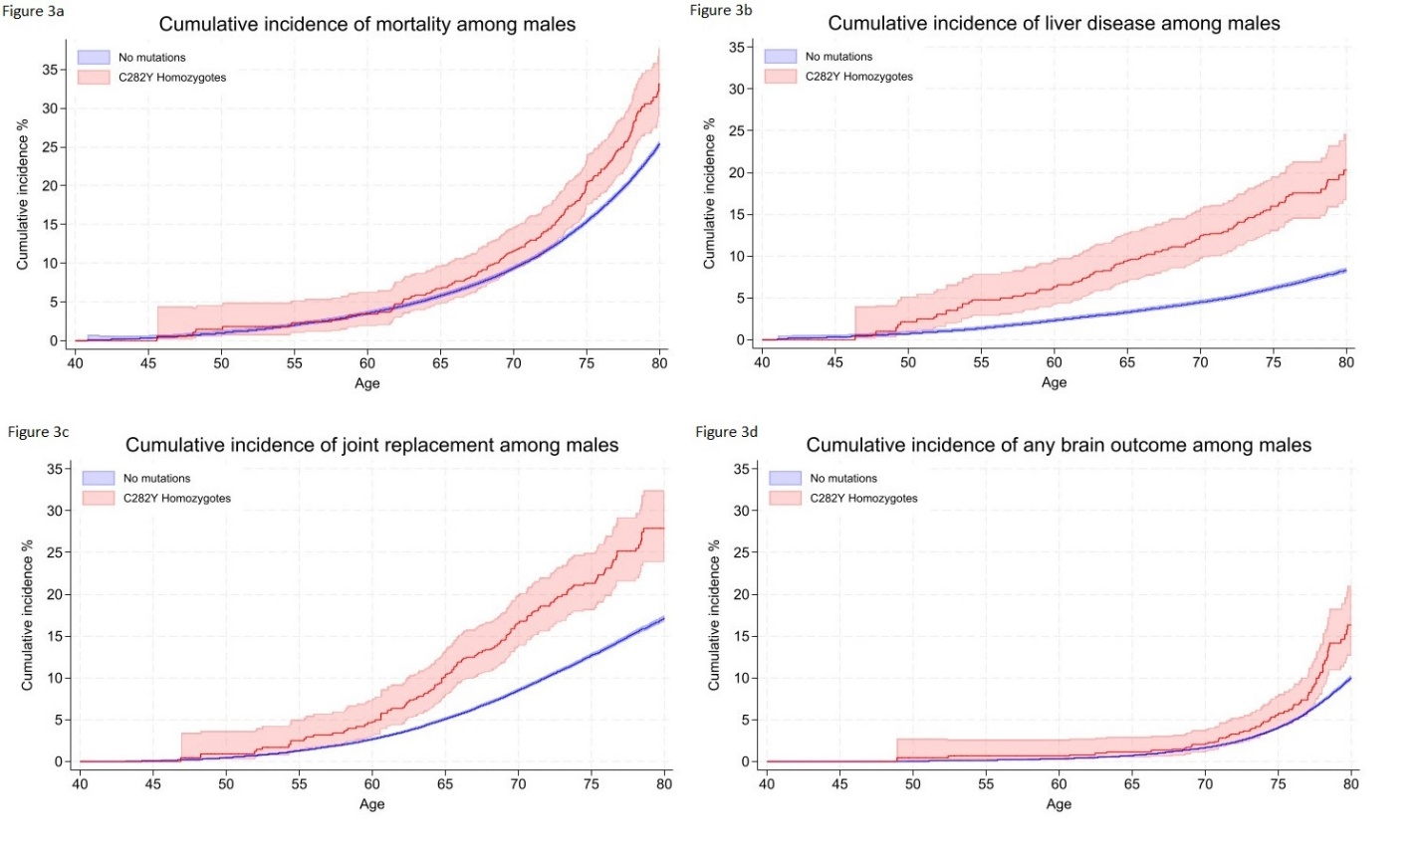
Haemochromatosis – cumulative incidence of specific outcomes by age 80
Male HFE p.C282Y homozygotes (n=1,318)
without haemochromatosis diagnosis
Mortality
Liver disease
HR=1.29 (1.12-1.48)
HR=2.56 (2.10-3.12)
Demonstrates underdiagnosis and higher penetrance of C282Y than previously thought
Mitchell Lucas
Dr Janice Atkins
Lucas et al. 2024. BMJ Open. doi: 10.1136/bmjopen-2023-081926

Slide 18
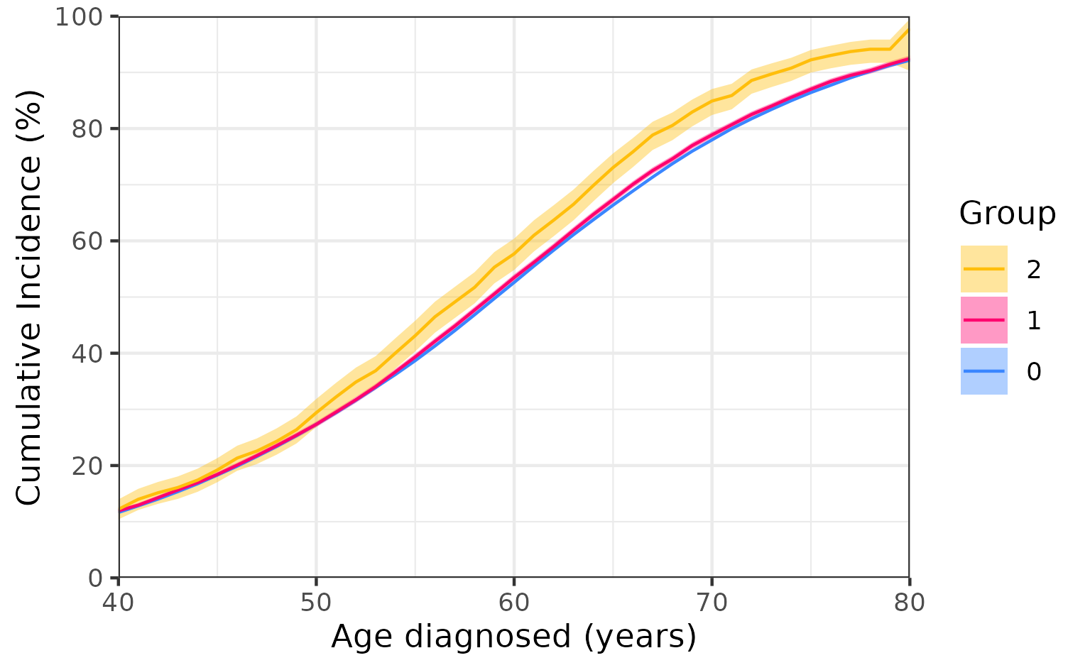
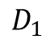

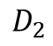
Haemochromatosis – cumulative incidence of multimorbidity
Male HFE p.C282Y homozygotes (n=1,318)
without haemochromatosis diagnosis
Effect on common long-term conditions
- GEMINI did not include liver disease or haemochromatosis
Age diagnosed with first GEMINI long-term condition
Cumulative incidence analysis
HR 1.36 (95%CI 1.21 to 1.52)
HFE genotype
C282Y homozygote
C282Y heterozygote
Wild type
$$D_{1}$$
$$D_{2}$$
6.9% excess by age 70
$$X$$
Unpublished work based on UKB data in main GEMINI analysis: Murrin et al. eBioMedicine, 2025. doi:10.1016/j.ebiom.2025.105584

Slide 19
Summary so far…
Substantial observational and genetic correlation between long-term conditions
BMI genetics affects 55% of condition-pairs tested, confirming role of obesity in multimorbidity
Specific pathways such as iron overload can increase burden of common diseases
But what else drives the genetic correlation between conditions?
Two more quick examples of our ongoing work
Murrin et al. 2025. eBioMedicine . doi:10.1016/j.ebiom.2025.105584
Mounier et al. 2024. medRxiv . doi:10.1101/2024.07.10.24309772
Lucas et al. 2024. BMJ Open. doi: 10.1136/bmjopen-2023-081926

Slide 20
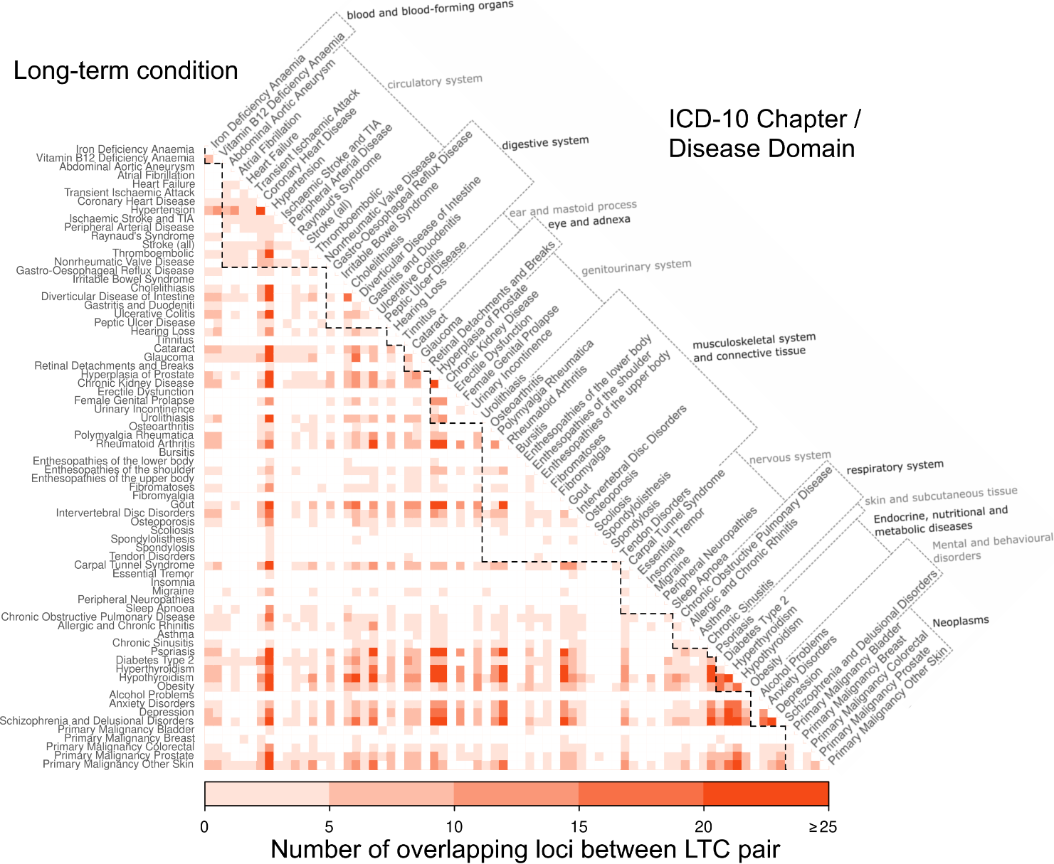
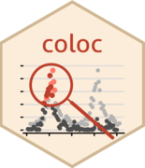
Substantial overlap at specific loci between pairs of long-term conditions
But which loci harbour causal variants for both conditions?
github.com/chr1swallace/coloc
Wang et al. 2020. JRSSB. doi:10.1111/rssb.12388
Focussing on:
1. “Interesting” pairs – e.g., where observational and genetic were discordant (RA~skin cancer – next slide)
2. Conditions associated with hypertension
3. Breathing and rheumatic conditions
4. Cluster of steroid-associated outcomes
Led by Bethany Voller
Unpublished work using summary statistics from main GEMINI analysis: Murrin et al. eBioMedicine, 2025. doi:10.1016/j.ebiom.2025.105584

Slide 21
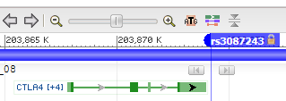
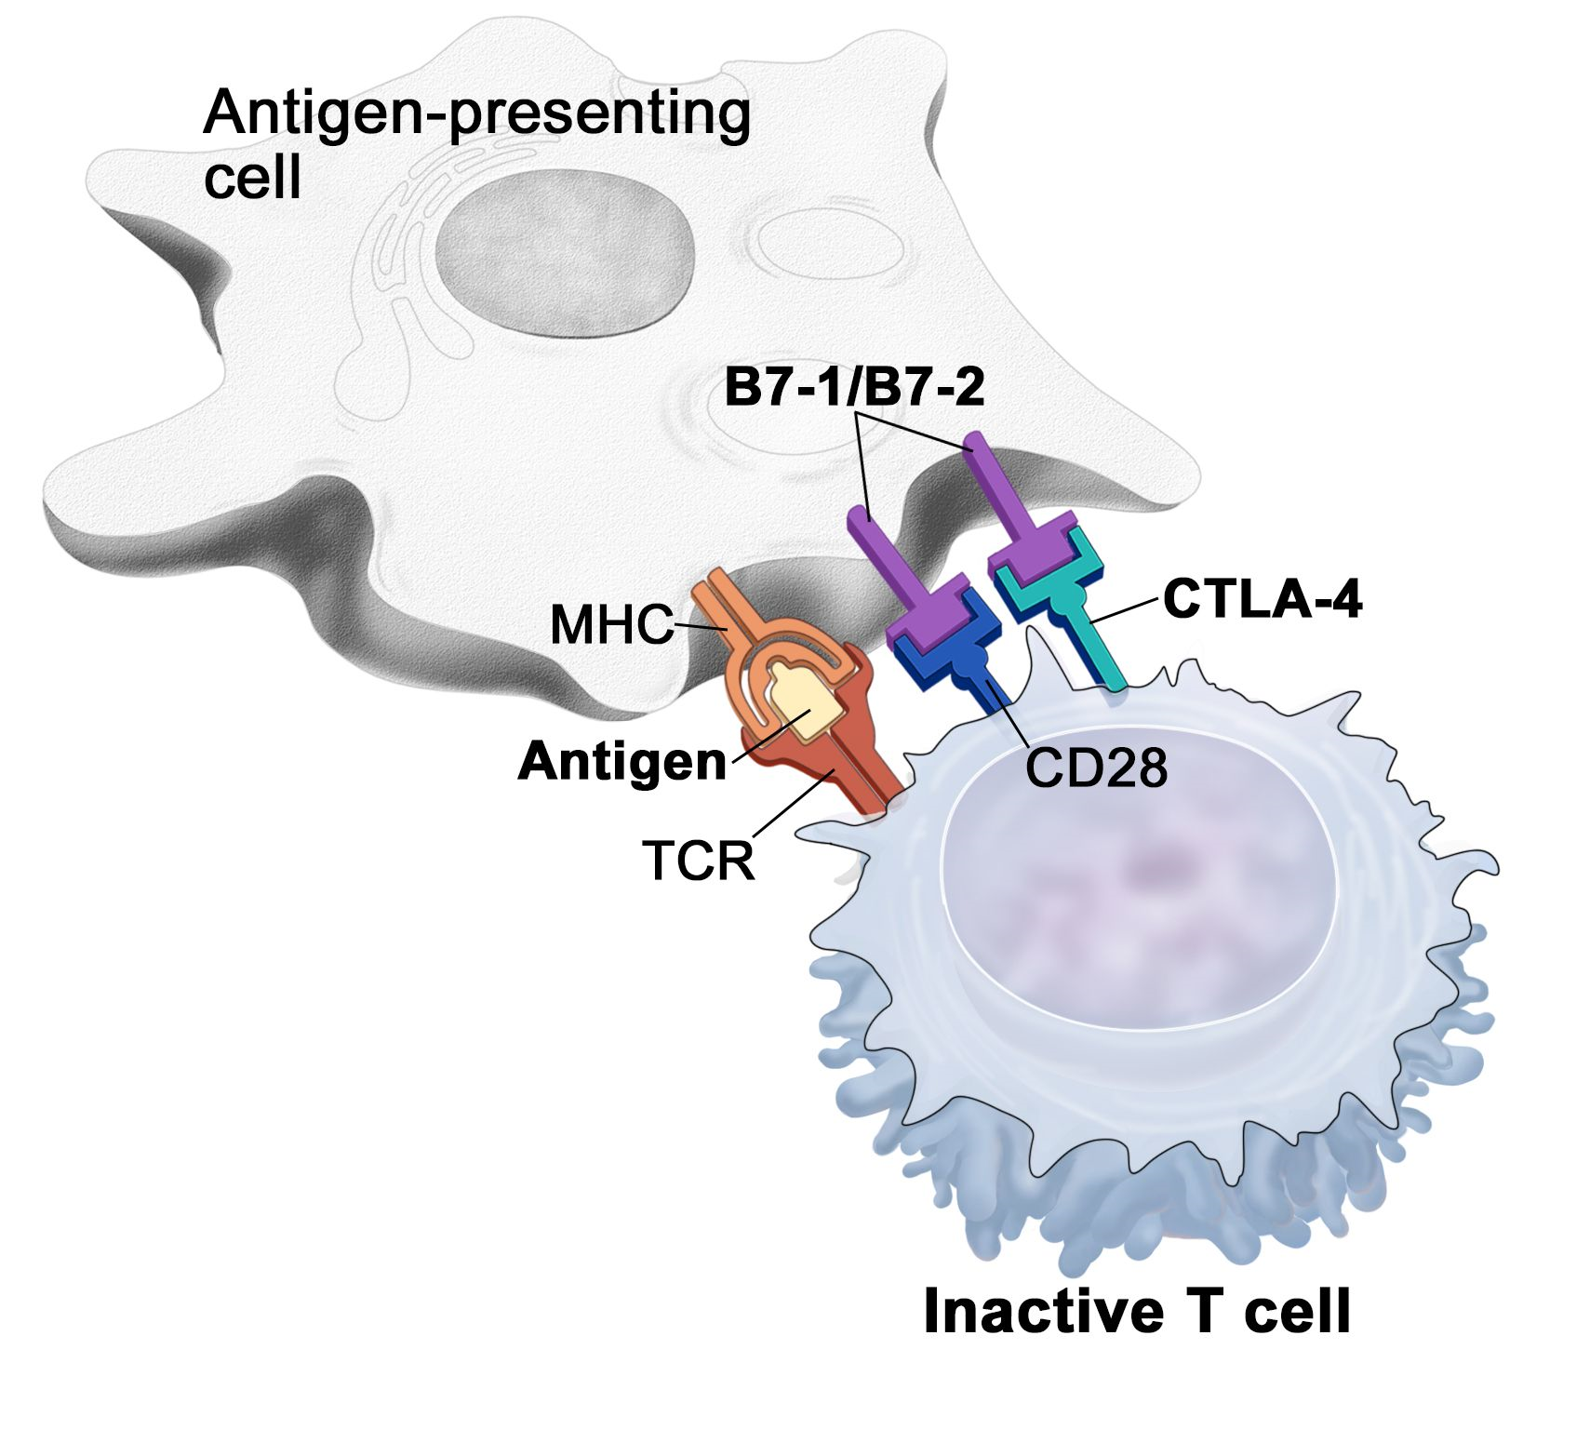
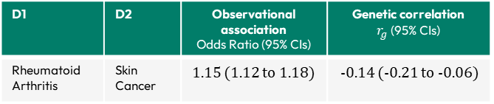
github.com/chr1swallace/coloc
Wang et al. 2020. JRSSB. doi:10.1111/rssb.12388
Rheumatoid Arthritis and Skin Cancer
Bethany Voller
Variant (rs3087243) had high evidence of colocalization i.e., causal for both RA and skin cancer (PP4=1)
Mapped to CTLA4 gene.
CTLA4 is a drug target for:
Cancers (e.g., ipilimumab: anti-CTLA4 antibody)
> Inhibits CTLA4
> promotes T-cell activation
> cancer cells targeted and killed
Rheumatoid arthritis (abatacept: CTLA4-Ig)
> Mimics CTLA4 signalling
> decreasing inflammation
D1 | D2 | Observational association Odds Ratio (95% CIs) | Genetic correlation $r_{g}$(95% CIs)
Rheumatoid Arthritis | Skin Cancer | 1.15 (1.12 to 1.18) | -0.14 (-0.21 to -0.06)
Figure from https://www.cancer.gov/publications/dictionaries/cancer-terms/def/ctla-4
Murrin et al. eBioMedicine, 2025. doi:10.1016/j.ebiom.2025.105584
.

Slide 22
Summary so far…
Substantial observational and genetic correlation between long-term conditions
BMI genetics affects 55% of condition-pairs tested, confirming role of obesity in multimorbidity
Specific pathways such as iron overload can increase burden of common diseases
Specific loci such as known drug target CTLA4 can explain observational and genetic correlations
One more example of our ongoing work
Murrin et al. 2025. eBioMedicine . doi:10.1016/j.ebiom.2025.105584
Mounier et al. 2024. medRxiv . doi:10.1101/2024.07.10.24309772
Lucas et al. 2024. BMJ Open. doi: 10.1136/bmjopen-2023-081926

Slide 23
Medications: adverse effects, adherence, and pharmacogenetics
Led by Dr Deniz Türkmen
With Profs
Jane Masoli
Jack Bowden
Lucas et al. 2024. BMJ Open. doi: 10.1136/bmjopen-2023-081926

Slide 24
GEMINI team Bethany Voller Dr Olivia Murrin Ruby Woodward Dr Ninon Mounier Dr Deniz Türkmen Dr João Delgado
Dr Lucía Carrasco
Dr Concepción Violán Prof Frank Dudbridge Prof Jane Masoli
Prof Jack Bowden Prof Tim Frayling (PI)
“GEMINI”
MR/W014548/1
PI: Prof Tim Frayling
Department of Clinical and Biomedical Sciences
Slides on my GitHub
“TWIST”
MR/X011372/1
PI: Prof Jack Bowden
“Ageing Well”
MR/M023095/1
PI: Prof David Melzer
Thank you!
L.Pilling@exeter.ac.uk
lcpilling.github.io
lcpilling.bsky.social
Resources
Et al…!
Team Iron Mitchell Lucas Daniel Williamson Lucy Banfield Dr Francesco Casanova Dr Jeremy Shearman Dr Janice Atkins Prof David Melzer
github.com/GEMINI-multimorbidity
gemini-multimorbidity.shinyapps.io/atlas
NIHR301844
PI: Dr Janice Atkins
sites.exeter.ac.uk/ironoverload
Research Contract
Co-PI: Dr Luke Pilling
MR/S009892/1
PI: Prof David Melzer

Slide 26
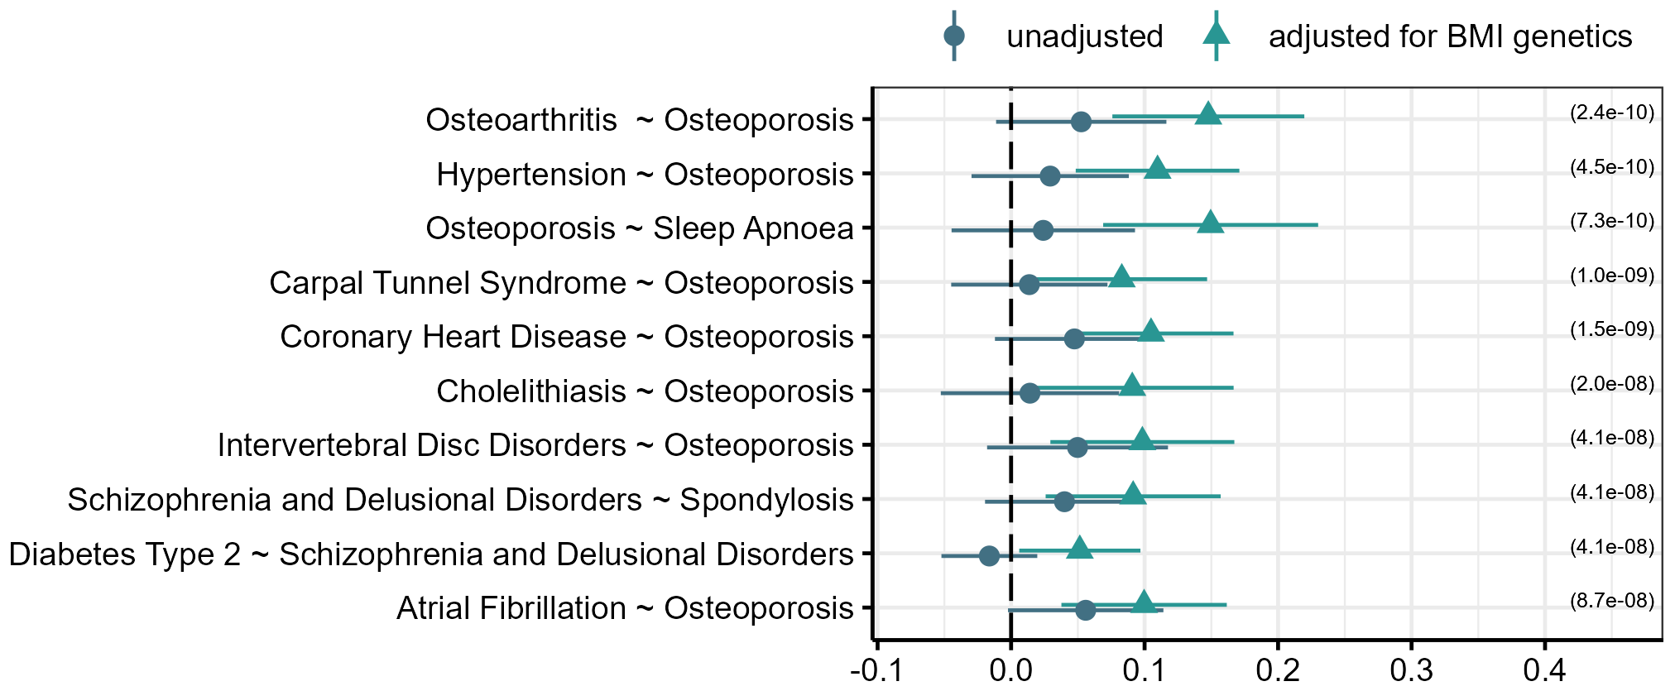
Condition pairs where BMI significantly increases the genetic correlation
Led by Dr Ninon Mounier
github.com/GEMINI-multimorbidity/partialLDSC
$$Y_{1}$$
$$Y_{2}$$
+
-
$$X$$
$$G$$
$r_{g|BMI}$(95% CIs)
For 33 pairs with no evidence of unadjusted genetic correlation, adjustment for BMI genetics made the correlation stronger
Most pairs included Osteoporosis, and can be explained by BMI reducing Osteoporosis risk, but increasing the risk of the other disease in the pair
Mounier et al. “Genetics identifies obesity as a shared risk factor for co-occurring multiple long-term conditions.” medRxiv. 2024. doi:10.1101/2024.07.10.24309772

Slide 27
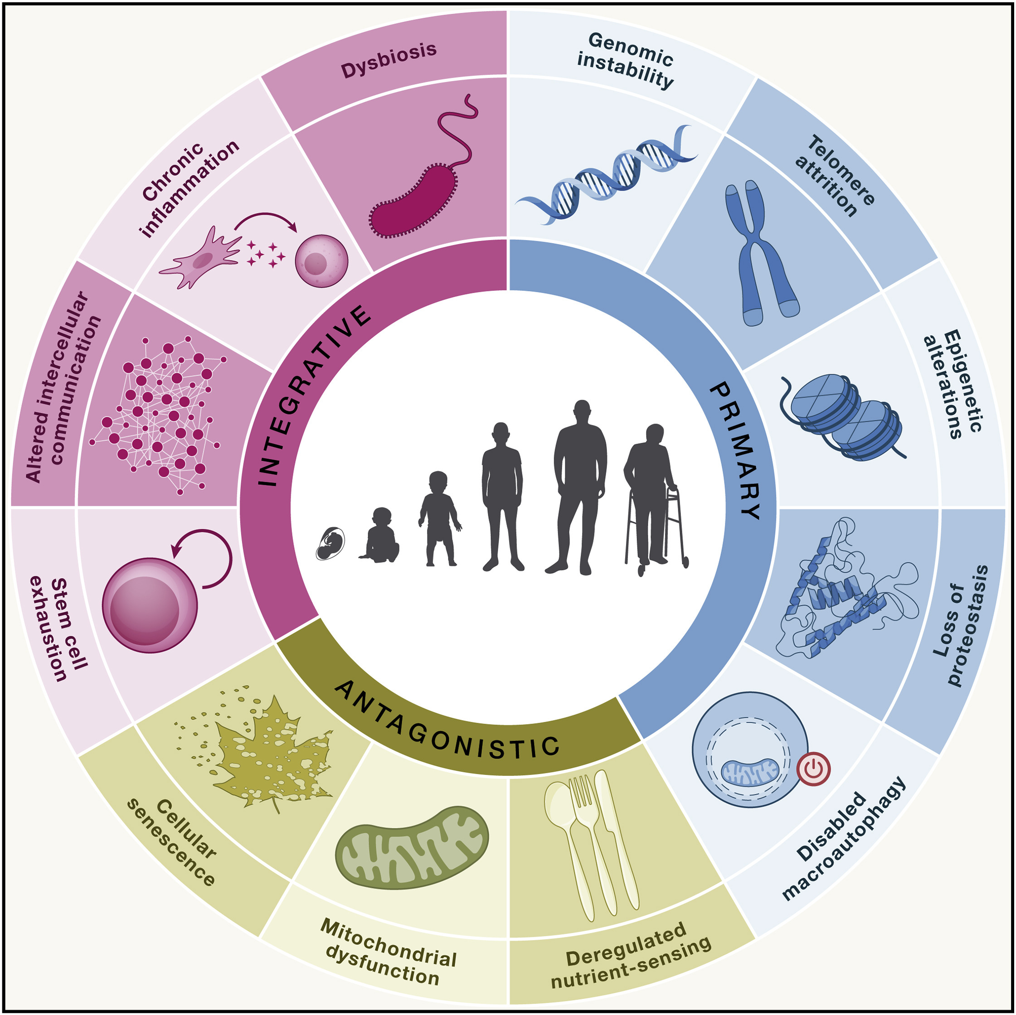
Biology of Ageing
Twelve proposed “hallmarks” of ageing [molecular, cellular, and systemic] – impact overall health and resilience of organisms
López-Otín et al. “Hallmarks of aging: An expanding universe” Cell, 2023. doi:10.1016/j.cell.2022.11.001

Slide 28
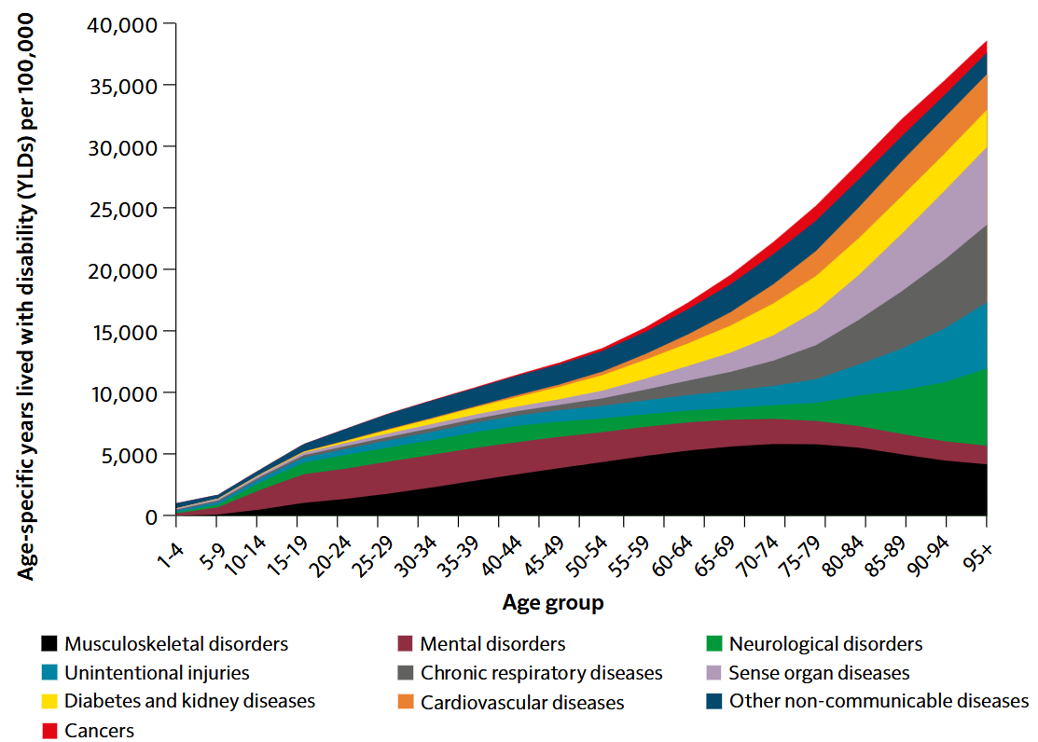
Ageing and accumulation of chronic diseases
Morbidity rate by age and top 10 broad causes (age-specific years lived with disability, persons England, in 2019)
UK Chief Medical Officer’s 2023 Annual Report: Health in an Ageing Society
Source data: Global Burden of Disease Study 2019 (GBD 2019), Institute for Health Metrics and Evaluation (2020)

